Slide 1
Role of AI in Stocks

Slide 2


STOCK MARKET

Slide 3
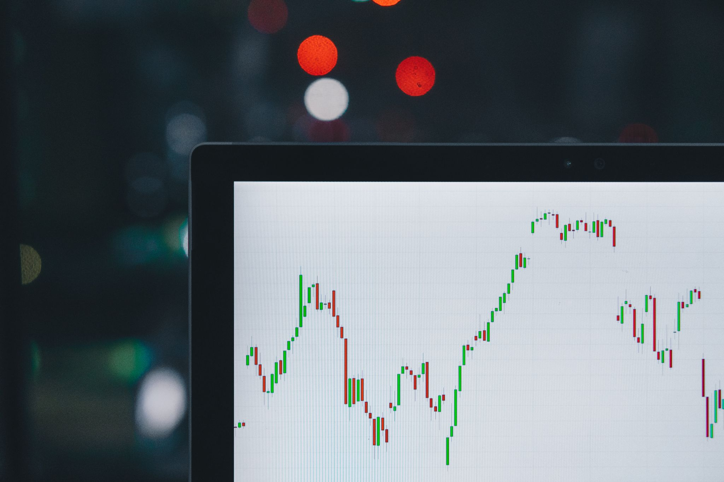
AI TOOLS

Slide 4
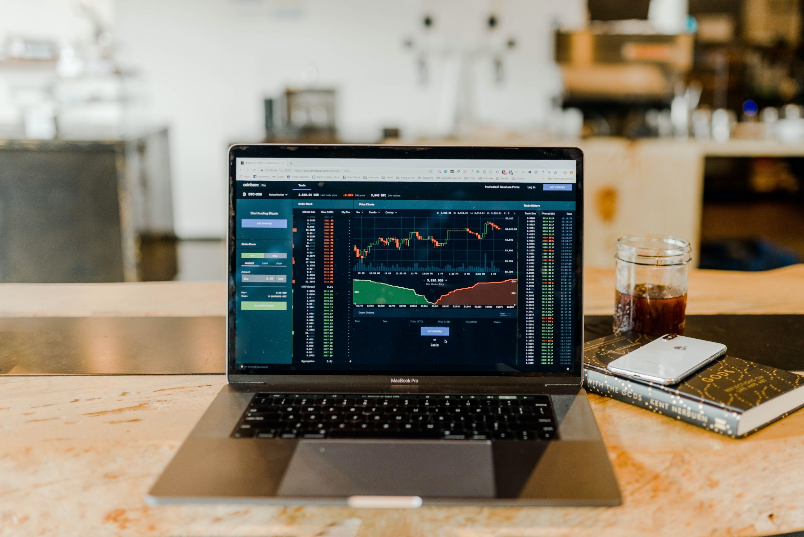
CONVENTIONAL APPROACHES

Slide 5
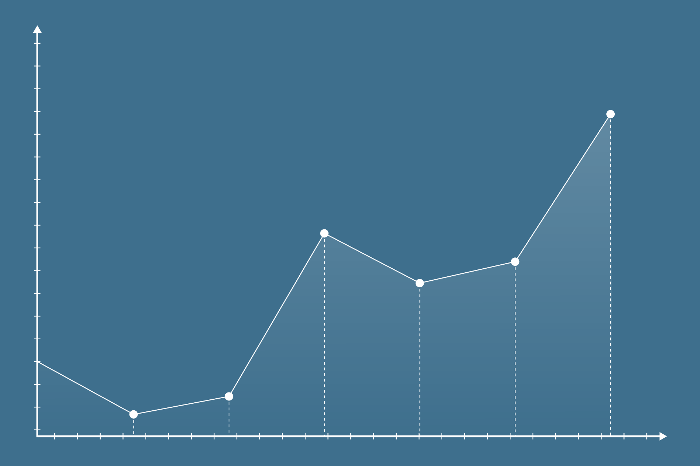
REGRESSIONS

Slide 6

SVM
ANN
SVR
BPNN

Slide 7

FLOW

Slide 8
